Slide 1


IT - 490 : Thesis
Comparative Sentiment Analysis of Public Perception: Monkeypox vs. COVID-19 Behavioral Insights
Team Members:
1. Mostafa Mohaimen Akand Faisal (2014755010)
2. Rabeya Amin Jhuma (2014755028)
Supervisor:
Barsha Roy
Lecturer,
Department of IT, UITS

Slide 2

Outline
Introduction
Motivation
Problem-Statement
Objectives
Related-Works
Dataset
Methodology
Applied-Algorithms
Result-Analysis
Comparison
Future-Directives
Conclusion
Reference
3/16/2025
2

Slide 3
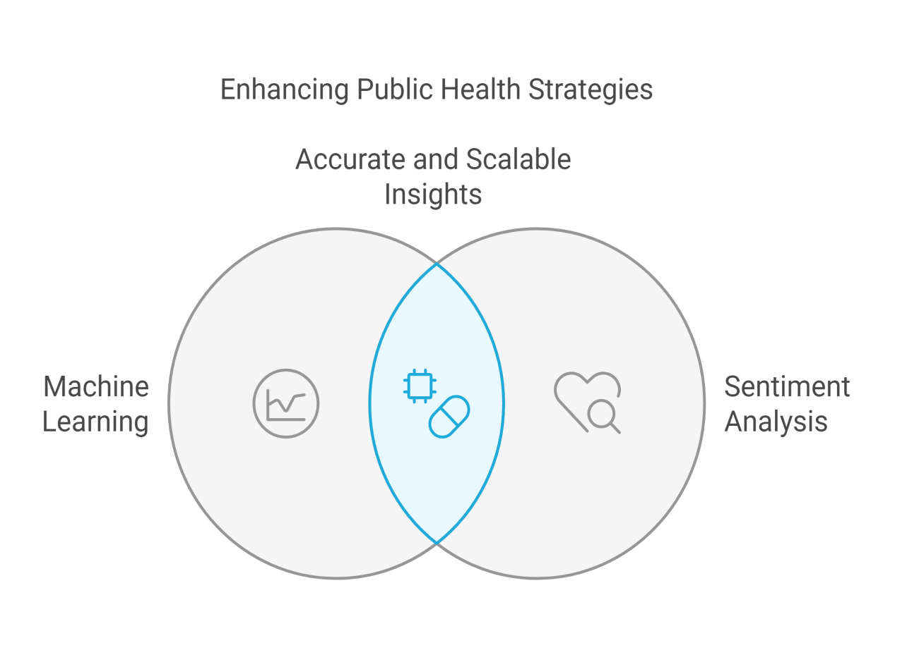
Introduction
Emergence of Infectious Diseases: Monkeypox and COVID-19 pose major challenges to public health management.
Role of Machine Learning: ML algorithms enable accurate, scalable sentiment analysis, offering actionable insights.
Impact: Supports better-informed health strategies and effective communication.

Slide 4
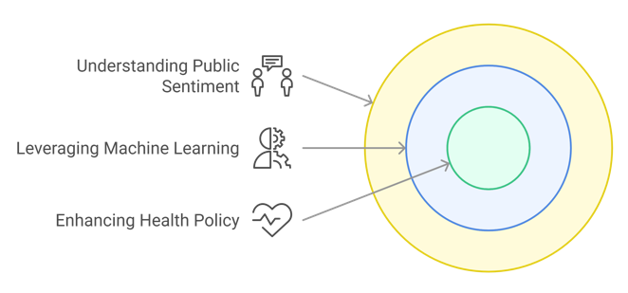
Motivation
Understanding Public Sentiment: Identify concerns and misconceptions to guide communication.
Leveraging Machine Learning: Enable accurate and scalable sentiment analysis.
Enhancing Health Policy: Provide actionable insights for targeted interventions.

Slide 5
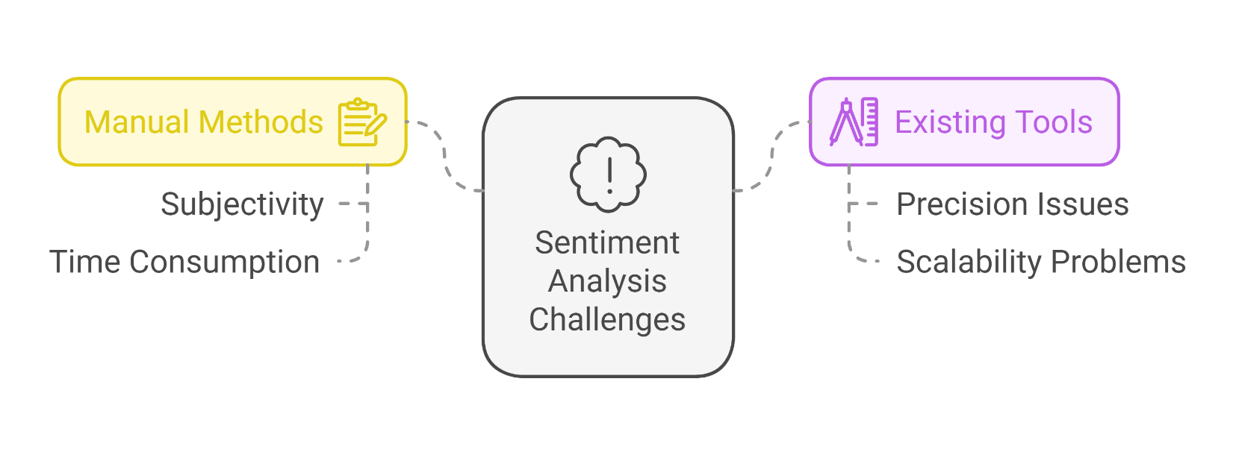
Problem Statement
Current Sentiment Analysis Challenges:
Manual sentiment analysis methods are often subjective and time-consuming.
Existing tools lack the precision and scalability needed to compare public perceptions of diseases like Monkeypox and COVID-19.

Slide 6
Objectives
Develop scalable sentiment analysis tools.
Analyze public sentiment for Monkeypox and COVID-19.
Guide health strategies through insights.
Enhance sentiment classification accuracy.
Facilitate comparative behavioral analysis.

Slide 7

Related Works
Related Works
Papers | Summary | Models Used | Best Performanc | Dataset Used
1. Fine-tuned Sentiment Analysis of COVID-19 Vaccine–Related Social Media Data: Comparative Study | The study uses two major social media platforms: Twitter and Reddit, used a fine-tuned DistilRoBERTa model aiming to understand how sentiments changed over time | Fine-tuned Distil Roberta (a robust variant of Roberta optimized for efficiency) | Accuracy: 95.92%, F1-Score: 95.92%, Precision: 95.61% | 9.5 million tweets from January 1, 2020, to March 1, 2022, filtered for "COVID Vaccine."
2. A Machine Learning-Sentiment Analysis on Monkeypox Outbreak: An Extensive Dataset to Show the Polarity of Public Opinion From Twitter Tweets | The research analyzes public sentiments using VADER and TextBlob. It develops machine learning models, with the SVM model achieving the highest accuracy. The findings aim to assist health authorities in understanding public perceptions and shaping effective health policies | K-Nearest Neighbor (KNN), Support Vector Machine (SVM), Random Forest, Logistic Regression, Multilayer Perceptron (MLP), Naïve BayesXGBoost | Accuracy: 93.48% (using TextBlob annotation + Lemmatization + CountVectorizer + SVM) | 107,000 tweets collected between July 2022 and September 2022
3/16/2025
7

Slide 8
Related Works
Related Works
Papers | Summary | Models Used | Best Performanc | Dataset Used
3. Sentiment Analysis and Text Analysis of the Public Discourse on Twitter about COVID-19 and MPox | This paper first study to compare discourse on both COVID-19 and MPox but lacks filtering of bot-generated tweets, impacting sentiment accuracy. | Random Forest, LR, Multilayer Perceptron, SVM, Naïve Bayes, KNN, XGB | RF = 90.05 LR = 89.51 Multilayer Perceptron = 91.86 SVM = 92.95 | The study analyzed a total of 61,862 Tweets collected over a specific time frame, from May 7, 2022, to March 3, 2023.
4. Improving Public Health Policy by Comparing the Public Response during the Start of COVID-19 and Monkeypox on Twitter in Germany: A Mixed Methods Study | Highlights platform-specific sentiment trends but limited by user demographics and lack of real-time analysis. | SVM, LR, Naïve Bayes, LDA | SVM = 88.3 LR = 85.6 Naïve Bayes = 81.2 | For COVID-19, tweets were collected between January 1, 2020, and March 31, 2020. A total of 8,532 tweets. For monkeypox, tweets were collected from May 1, 2022, to July 31, 2022. Total 7,404 tweets,
3/16/2025
3/16/2025
8
8

Slide 9
Dataset Details
Name: Covid-19 Twitter Dataset, Monkeypox Tweets, Tweets on monkeypox, Monkeypox tweets data
COVID-19 Data: 147,475
Monkeypox Data: 106,638
Dataset Attributes: ID, date, tweet sources ,hashtags, mentions, liked tweets, sentiment, tagging.

Slide 10
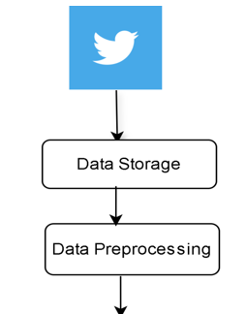
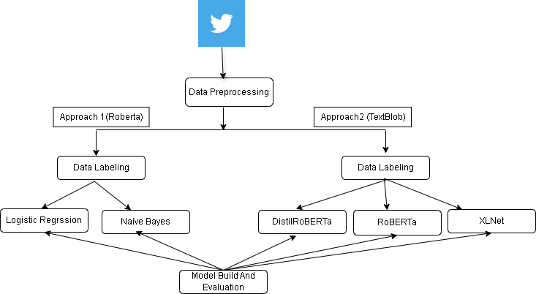
Methodology
Experimental framework
Fig 1: Flow of Work
3/16/2025
10

Slide 11
Methodology Cont’d
Data Preprocessing
Text Cleaning: Removing URLs, special characters, and irrelevant words.
Stopword Removal: Custom stopwords for COVID-19 and Monkeypox keywords.
Tokenization: Breaking down tweets into words.
TF-IDF Vectorizer: Captures the importance of words in the text data.
RoBERTa: Enables capturing rich contextual representations of text.
TextBlob : Makes text data analysis straightforward.
Sentiment Assignment: Categorizing tweets into positive, negative, and neutral based on polarity.

Slide 12
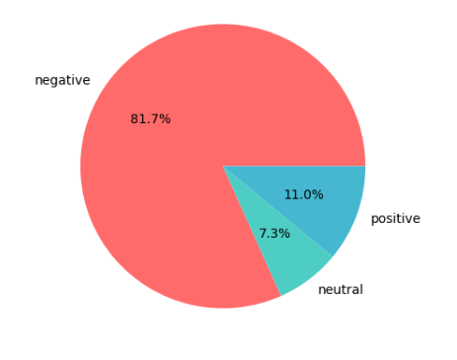
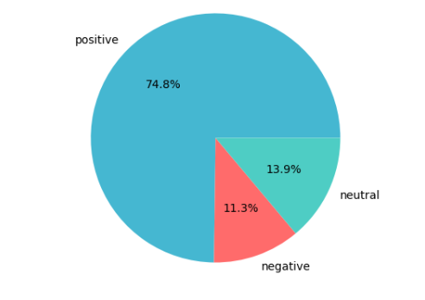
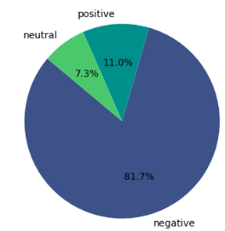
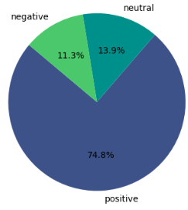
Methodology Cont’d
Data Visualization(approach 1)
COVID-19
MONKEYPOX
3/16/2025
Fig 2: Sentiment Distribution (RoBERTa Sentiment Analysis)
12

Slide 13
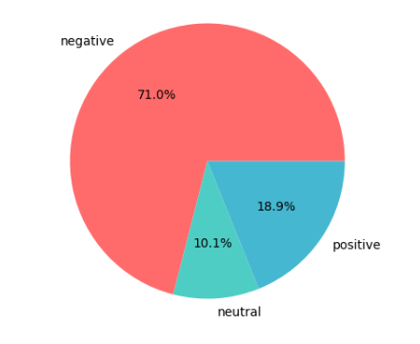
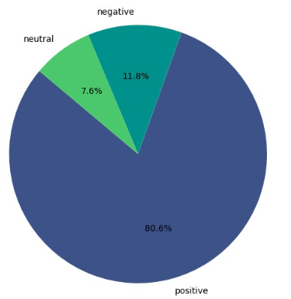
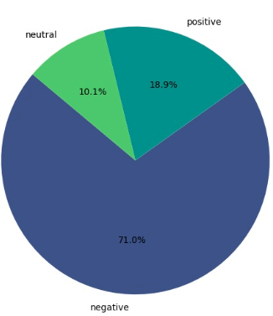
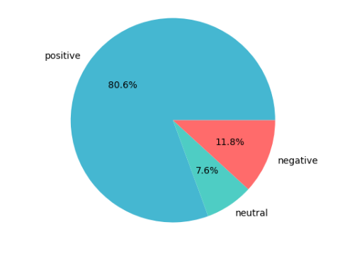
Data Visualization(approach 2)
Methodology Cont’d
COVID-19
MONKEYPOX
Fig 3: Sentiment Distribution (TextBlob Sentiment Analysis)

Slide 14
Methodology Cont’d
Applied Methods
Traditional Machine Learning Models
Logistic Regression:
Trained a multinomial Logistic Regression model as a baseline for sentiment classification.
Naive Bayes:
Trained a Naive Bayes classifier (MultinomialNB) for sentiment analysis, utilizing a TF-IDF vectorizer for feature extraction.
Transformer-based Models
ROBERTA:
Fine-tuned (Pre-trained Transformer) the Roberta-base model for sentiment classification.
XLNet:
fine-tuned (Pre-trained Transformer) architecture capable of leveraging bidirectional context for better understanding of input text.
DistilRoBERTa:
Trained a transformer-based DistilRoBERTa model for sentiment classification, being a distilled version of RoBERTa

Slide 15
Environment Setup
Platform: Google Colab
Hardware Configuration:
GPU Enabled: Configured through Runtime > Change runtime type > GPU.
RAM: High-RAM mode (12GB) was utilized via Colab to support the computational demands of the experiment.

Slide 16
Model Comparison
Parameter/Attribute | Logistic Regression | Naive Bayes
Loss Function | Not applicable (Logistic regression optimizes log-loss internally) | Multinomial log-likelihood loss
Optimizer | lbfgs (default for Scikit-learn multinomial Logistic Regression) | Uses Maximum Likelihood Estimation (MLE) for fitting the model
Activation Function | Softmax | No activation function (direct calculation based on probabilities)
Learning Rate | Not directly adjustable | Not applicable (model parameters are directly computed)
Vectorization/Embedding | TF-IDF (max_features = 5000) | TF-IDF vectorization (max_features=5000)
Input Text Preprocessing | Lowercasing, tokenization, and TF-IDF | Lowercasing, tokenization, and TF-IDF
Evaluation Metric | COVID(87.69%), Monkeypox(82.96%) | COVID(70.00%), Monkeypox(94.00%)
Dataset Split | 80% Training, 20% Testing | 80% Training, 20% Testing

Slide 17
Model Comparison Cont’d
Parameter/Attribute | ROBERTA | XLNet | DistilRoberta
Loss Function | Sparse Categorical Crossentropy | SparseCategorical Crossentropy | SparseCategorical Crossentropy
Optimizer | AdamW | Adam | Adam
Activation Function | GeLU | Linear (logits for multi-class classification) | Linear (logits for multi-class classification)
Learning Rate | 2e-5 | 2e-5 | 3e-5
Vectorization/Embedding | ROBERTA Tokenizer | XLNet tokenizer | DistilRoBERTa tokenizer
Input Text Preprocessing | Tokenization, padding, truncation (max length = 50) | Tokenization (max_length=64) | Tokenization (max_length=128)
Evaluation Metric | COVID(97.99%), Monkeypox (95.36%) | COVID(97.05%), Monkeypox (96.82%) | COVID(97.51%), Monkeypox (95.19%)
Dataset Split | 80% Training, 20% Testing | 80% Training, 20% Testing | 80% Training, 20% Testing

Slide 18
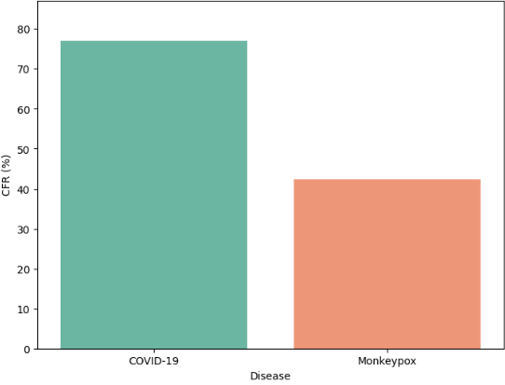
Correlation
CFR ( Extremely Case Fatality Rate Comparison )
COVID-19 CFR : 77.08%
Monkey pox CFR42: 42.38%
CFR Calculation:
CFR (%) = (Deaths/Cases)×100
Deaths: Refers to the total number of deaths
Cases: Refers to the total number of confirmed cases
Percentage Conversion: The result of the division is multiplied by 100
3/16/2025
3/16/2025
18
Fig 2: CFR Comparison
18

Slide 19
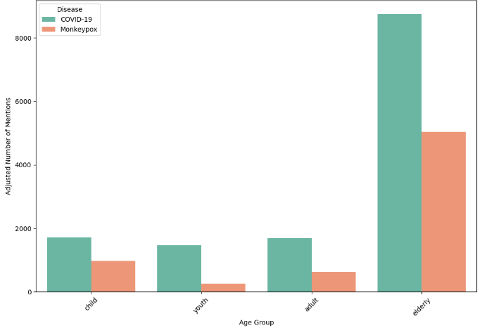
Correlation Cont’d
Age Distribution of Cases (Based on Death Rate)
Fig 2: Age Distribution of Cases COVID vs Monkey pox
3/16/2025
3/16/2025
3/16/2025
19
19
19

Slide 20
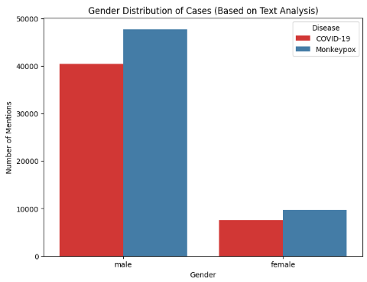
Correlation Cont’d
Gender Distribution of Cases
3/16/2025
Fig 2: Gender Distribution of Cases COVID vs Monkey pox
3/16/2025
3/16/2025
20
20
20

Slide 21
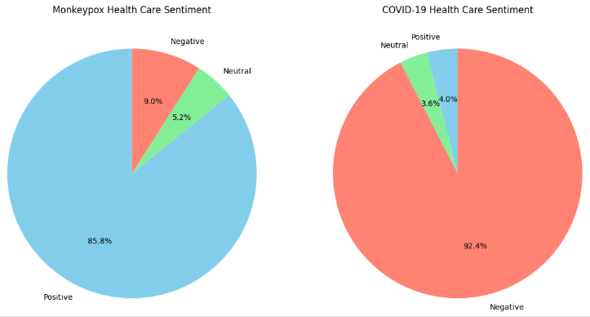
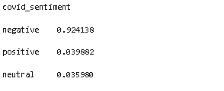
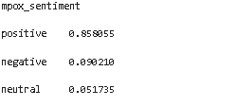
Correlation Cont’d
Healthcare System Trust Analysis
Fig 2: Healthcare System Trust Analysis COVID vs Monkey pox
3/16/2025
3/16/2025
3/16/2025
21
21
21

Slide 22
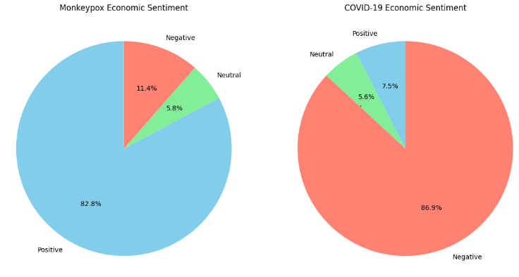
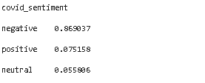
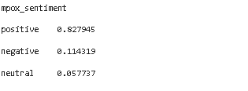
Correlation Cont’d
Economic Impact Perception
Fig 2: Economic Impact Perception COVID vs Monkey pox
3/16/2025
3/16/2025
3/16/2025
3/16/2025
22
22
22
22

Slide 23
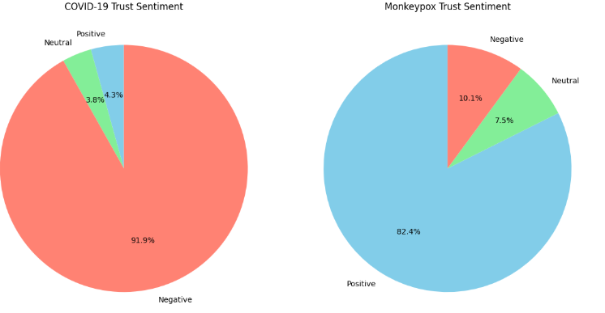
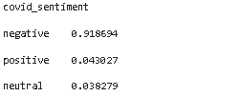
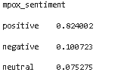
Correlation Cont’d
Information Source Trust Comparison
Fig 2: Information Source Trust Comparison COVID vs Monkey pox
3/16/2025
3/16/2025
3/16/2025
3/16/2025
3/16/2025
3/16/2025
23
23
23
23
23
23

Slide 24
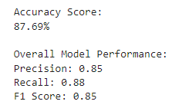
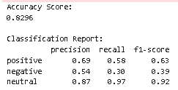
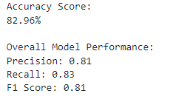
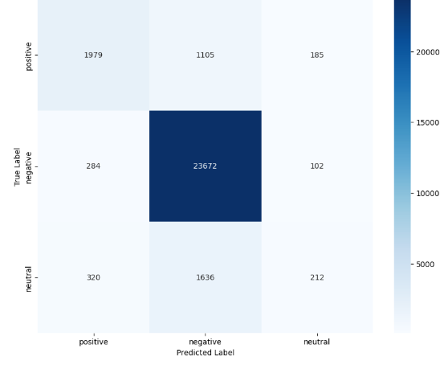
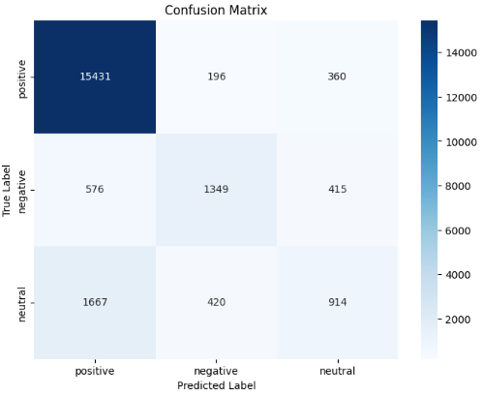
Result and Performance Analysis Cont’d
COVID-19
MONKEYPOX
Fig 4: Classification Report of Logistic Regression

Slide 25


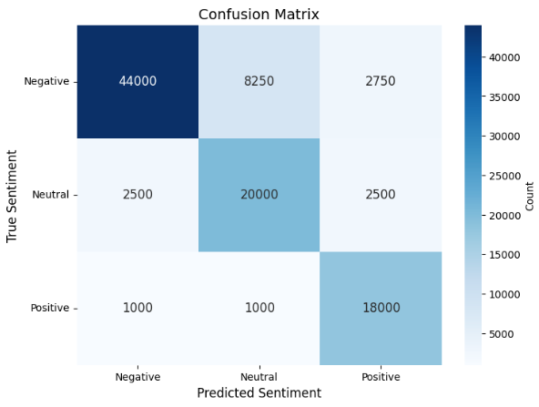
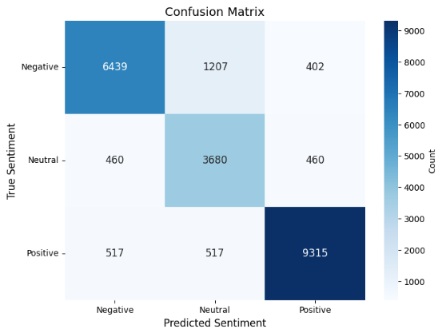
Result and Performance Analysis Cont’d
COVID-19
MONKEYPOX
Fig 4: Classification Report of Naive Bayes

Slide 26
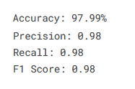
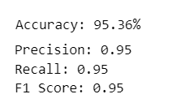
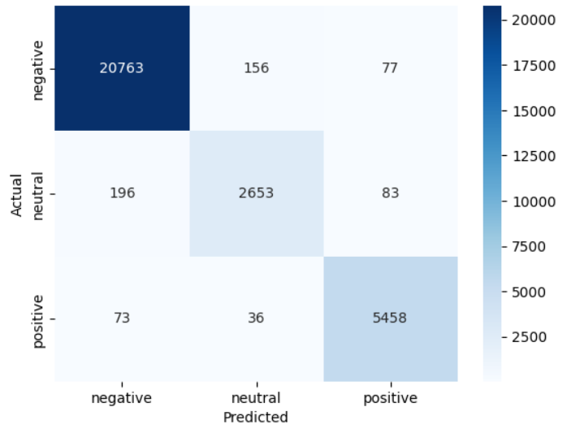
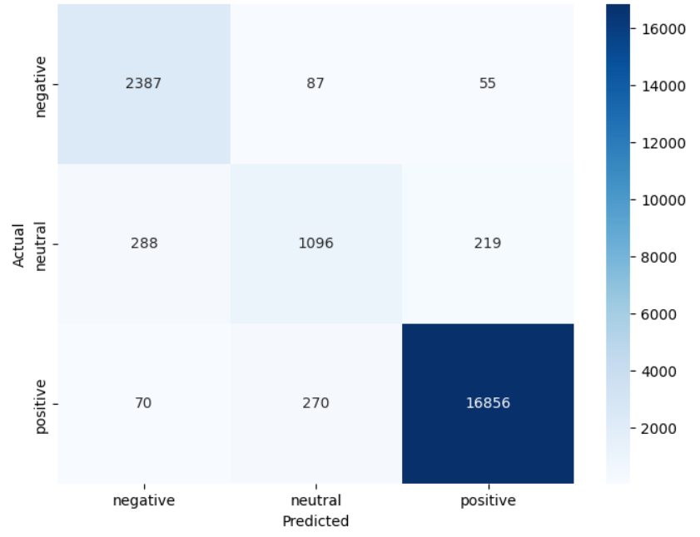
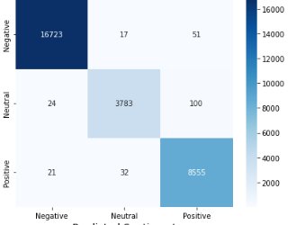
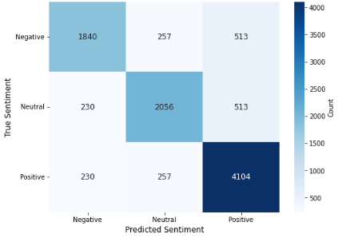
Result and Performance Analysis Cont’d
COVID-19
MONKEYPOX
Fig 5: Classification Report of ROBERTA

Slide 27


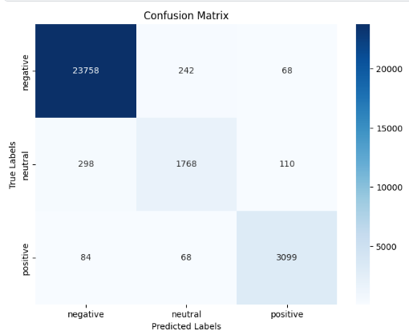
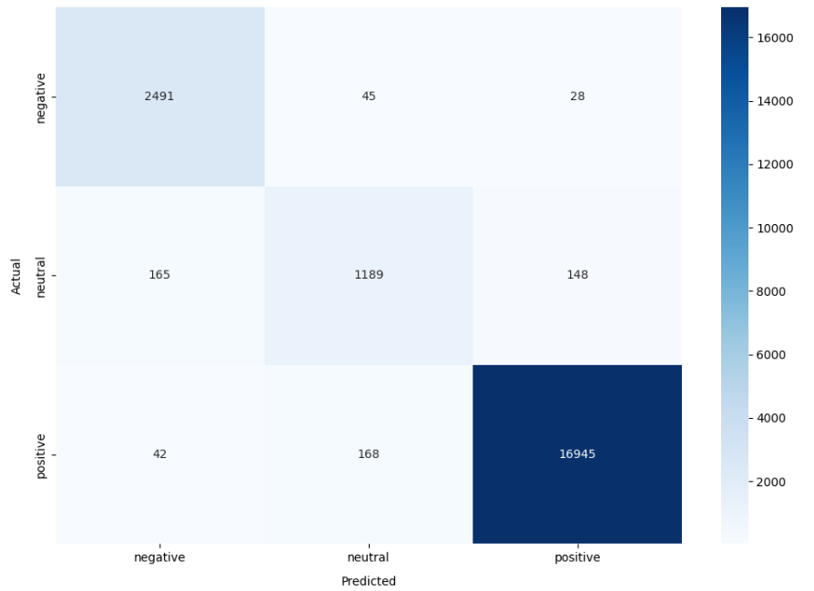
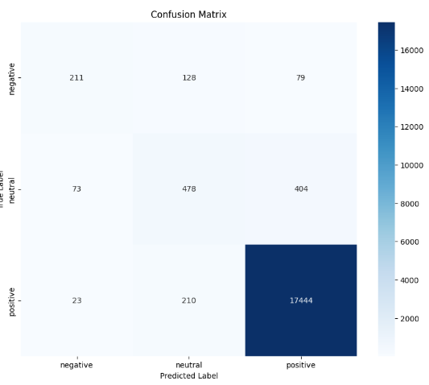
Result and Performance Analysis Cont’d
COVID-19
MONKEYPOX
3/16/2025
Fig 5: Classification Report of XLNet
27

Slide 28


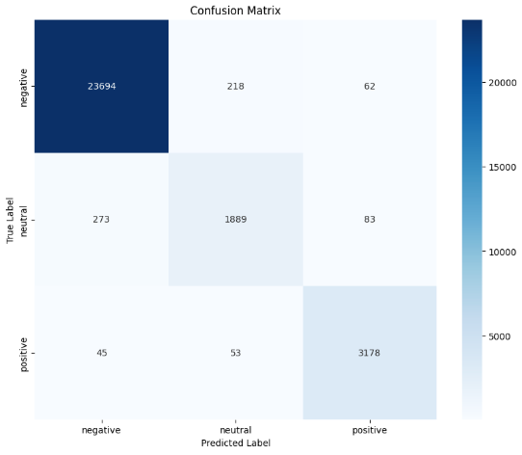
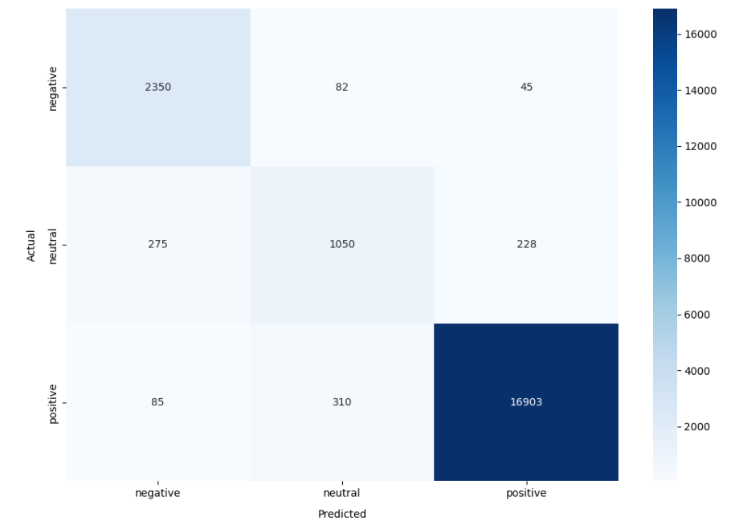
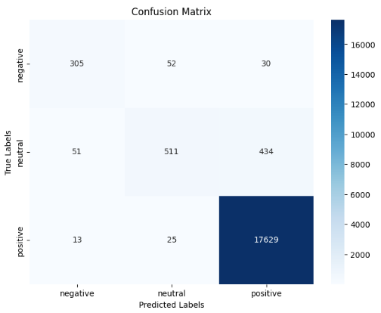
Result and Performance Analysis Cont’d
COVID-19
MONKEYPOX
3/16/2025
Fig 5: Classification Report of DistilRoBERTa
3/16/2025
28
28

Slide 29
Future Work
Improving Models
API
Correlate
3/16/2025
29

Slide 30
Conclusion
Analyzing Public Perception
Sentiment and Behavior Differences
Model Comparison
Importance of Model Choice
3/16/2025
3/16/2025
30
30

Slide 31
Referances Cont’d
Melton C, White B, Davis R, Bednarczyk R, Shaban-Nejad AFine-tuned Sentiment Analysis of COVID-19 Vaccine–Related Social Media Data: Comparative StudyJ Med Internet Res 2022;24(10):e40408URL: https://www.jmir.org/2022/10/e40408DOI: 10.2196/40408
Staphord Bengesi, Timothy Oladunni and Ruth Olusegun et al. A Machine Learning-Sentiment Analysis on Monkeypox Outbreak: An Extensive Dataset to Show the Polarity of Public Opinion From Twitter Tweets. IEEE Access. 2023. Vol. 11:11811-11826. DOI: 10.1109/ACCESS.2023.3242290
Al-Ahdal, Tareq et al. “Improving Public Health Policy by Comparing the Public Response during the Start of COVID-19 and Monkeypox on Twitter in Germany: A Mixed Methods Study.” Vaccines vol. 10,12 1985. 22 Nov. 2022, doi:10.3390/vaccines10121985
Thakur, N. (2023). Sentiment Analysis and Text Analysis of the Public Discourse on Twitter about COVID-19 and MPox. Big Data and Cognitive Computing, 7(2), 116. https://doi.org/10.3390/bdcc7020116
Liu, Yinhan et al. “RoBERTa: A Robustly Optimized BERT Pretraining Approach.” ArXiv abs/1907.11692 (2019): n. pag.
3/16/2025
3/16/2025
3/16/2025
3/16/2025
31
31
31
31

Slide 32
Referances Cont’d
P. Rajapaksha, R. Farahbakhsh and N. Crespi, "BERT, XLNet or RoBERTa: The Best Transfer Learning Model to Detect Clickbaits," in IEEE Access, vol. 9, pp. 154704-154716, 2021, doi: 10.1109/ACCESS.2021.3128742.
Y. Liu, M. Ott, N. Goyal, J. Du, M. Joshi, D. Chen, et al., "RoBERTa: A robustly optimized BERT pretraining approach", arXiv:1907.11692, 2019.
P. Rajapaksha, R. Farahbakhsh and N. Crespi, "BERT, XLNet or RoBERTa: The Best Transfer Learning Model to Detect Clickbaits," in IEEE Access, vol. 9, pp. 154704-154716, 2021, doi: 10.1109/ACCESS.2021.3128742.
Y. Liu, M. Ott, N. Goyal, J. Du, M. Joshi, D. Chen, et al., "RoBERTa: A robustly optimized BERT pretraining approach", arXiv:1907.11692, 2019.
Liu, Yinhan et al. “RoBERTa: A Robustly Optimized BERT Pretraining Approach.” ArXiv abs/1907.11692 (2019): n. pag.
Majid, Abdul et al. “Sentiment Analysis on Tiktok Application Reviews Using Natural Language Processing Approach.” Journal of Embedded Systems, Security and Intelligent Systems (2023): n. pag.
3/16/2025
3/16/2025
3/16/2025
32
32
32

Slide 33
THANK YOU

